Slide 1
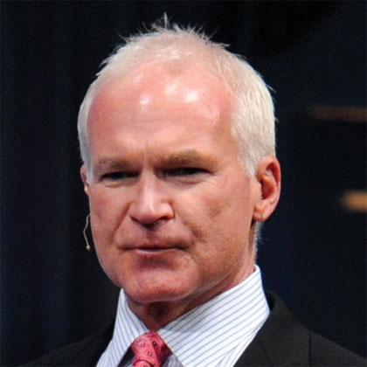
Kevin Buckman
特別企劃顧問
Special Projects Consultant

Slide 2


購物年金
The Shopping Annuity®
轉消費為收入
Convert Spending Into Earning
Notes:
TRAINERS NOTES:
Welcome guests. Let them know that why you’re excited to be sharing this revolutionary concept with them.
It gives everyone a chance to enjoy the benefits of annuity without having to fund it with discretionary income, but rather with money they are already spending
We are going to show you how you could create a residual income for yourself by simply changing how you shop and duplicating it with your team
This plan is essentially rocket fuel for the MPCP.
Share any of your personal success or team’s success with the Shopping Annuity

Slide 3


Slide 4

美安香港最受歡迎的產品就是超連鎖事業發展系統
Market Hong Kong’s number one selling product is its UnFranchise Business System
  「系統為企業家創造優渥的永續收入，同時為世界各地的消費者提供更好的購物方式。」
  “System for entrepreneurs to create a significant ongoing income, while providing consumers with a better way to shop. ”
美安香港的業績紅利計劃（MPCP）正是這系統的核心，鼓勵每位超連鎖店主改變他們購物習慣。
At the heart of this system is Market Hong Kong’s Management Performance Compensation Plan (MPCP) that rewards each UnFranchise Owner (UFO) for changing what they shop for and how they shop for it.
Notes:
TRAINERS NOTES:
With the UnFranchise, anyone can build a residual income for themselves by implementing our proven plan.
There are many ways to build assets for yourself including: savings, stock, 4% returns, Whole-life insurance etc. With these types of investments, the return on investment is not guaranteed and the deal can change at any time. It is essentially a risk.
On the contrary, the MPCP allows you to build a strong asset where you know exactly what your ROI is based on the amount of BV and IBV your organization creates.
Transition into the next slide – Let’s take a closer look at other popular investments and how we compare.

Slide 5

在今天的銀行匯率下，你有這麼多現金作出投資嗎？Will you have this cash invested in the bank at today’s rates ?
超連鎖™永續收入 UnFranchise™ Ongoing Income | 4%的投資法則Equivalent Investment earning at 4%
$4,600 / Month (經理級Executive coordinator/ 主管經理級Master) | $1,380,000
$34,500 / Month (專業經理級Professional coordinator) | $11,040,000
$76,600 / Month (總顧問經理級National supervising) | $24,512,000
$138,000 / Month (高級顧問經理級Director) | $44,850,000
$276,000 / Month ( 副總裁級Field Vice President) | $92,000,000
超連鎖™收入
UnFranchise™ Income
vs.
4%的投資法則
The 4% Rule Investment
Notes:
Celine:
Figures have been changed to HK amounts.
TRAINERS NOTES:
The 4% Rule is a popular investment-income strategy that says as long as you withdraw no more than 4% of your initial portfolio, adjusted for inflation, on an annual basis during your retirement years, you shouldn't run out of money.
Take a look at what it would take to create a $4,600/month payment to yourself at retirement, following this rule. It would take $450,000 in the bank! Would you have that money saved up by retirement?
Most Americans are living paycheck to paycheck with little to no savings. How will they get it done? The answer is that most won’t, and therefore will never have the 4% rule as a viable retirement option.
With Market America, you could create a $4,600 / month asset as an executive coordinator or master coordinator. And even more, after 2-3 years of following our proven plan you could create a residual income of $1,420,000 / year. That is the equivalent of living off of 4% of a $5MILLION asset in the bank!
Think even further – if you built the UnFranchise as a way to enjoy residual income because you didn’t have the savings to participate in the 4% rule, now you can create the savings and earn both – the Residual Income from your UnFranchise and the 4% off the income you save!

Slide 6

甚麼是年金What is an Annuity
「年金」年金是指你在等額、定期的系列收支。An “Annuity” is a process by which a fixed payment is made to you at specified intervals for a specified length of time.
建立「年金」時，你必須在有收支前先投入一筆固定的資金。To fund the “Annuity” you must contribute a fixed sum payment before payouts to you may begin.
Notes:
TRAINERS NOTES:
Again, this is a popular investment and/or retirement strategy.
The benefit is that by paying into your annuity over time, you can expect to be paid back payments at retirement in monthly, quarterly, yearly or even lump sum payments based on your specific arrangements.
The downfall is that in order to fund the annuity, you need discretionary income to pay into it with. Most Americans have little to no discretionary income, therefore, cannot participate in an annuity program as part of their retirement strategy.

Slide 7

What is a甚麼是
購物年金
Shopping annuity®
Notes:
TRAINERS NOTES:
The Shopping Annuity is a revolutionary concept which levels the playing field. Because of how it works, anyone can enjoy the same major benefits of an annuity (receiving income as a result of funding) but with One Major Difference!

Slide 8
美安香港的「年金」和普通的「年金」大致相同，但最大的分別是︰The Shopping Annuity® works the same way with one major difference:
超連鎖店主要先投入的並不是資金，而是時間和購物習慣。A UFO’s specified fixed sum payment is made not in legal tender, but in time & changed shopping habits.
你到SHOP.COM購物就是你購物年金的投資。You create your “fixed sum payment” by redirecting purchases you’re already making to SHOP.COM to fund your Shopping Annuity.
通過執行在購物年金手冊中的4個基本步驟，並確保你兩個銷售組織中每位夥伴重複這些步驟，你以後每週就可賺取HK$4,600或以上的收入！By performing the 4 Basic Steps in the Shopping Annuity Handbook and ensuring all business partners within your two sales and distribution organizations duplicate these steps, you can reasonably expect to earn $4600 per week or more forever!
Notes:
TRAINERS NOTES:
The Shopping Annuity is not funded with discretionary income or “fixed sum payments’
The shopping annuity is funded by redirecting money you are already spending on monthly, seasonal and annual expenses to SHOP.COM.
By changing how you shop and duplicating this in your organization, you fund your shopping annuity and build a residual income for yourself.
The hardest point to make here is that you are USING MONEY YOU’RE ALREADY SPENDING, rather than applying discretionary income.
RECURRING THEME – We This is the first time we hit it…. You fund your Shopping Annuity with money you are already spending by redirecting purchases to SHOP.COM. People MUST grasp this concept if we are going to get adaption. That adaption is critical for their success with the Shopping Annuity.

Slide 9
傳統的年金TRADITIONAL ANNUITY:
你必須擁有穩定收入來支付年金所需的定額本金。You must have discretionary income to make fixed sum payments which fund your annuity.
購物年金SHOPPING ANNUITY®:
把你花在SHOP.COM上的金錢重新定位，你就可以有本金來打造你的購物年金。By redirecting money you are already spending to SHOP.COM, you create your “fixed sum payment” to fund your Shopping Annuity.
Notes:
TRAINERS NOTES:
This is a wrap up slide – a chance for you to summarize the key points side by side.

Slide 10
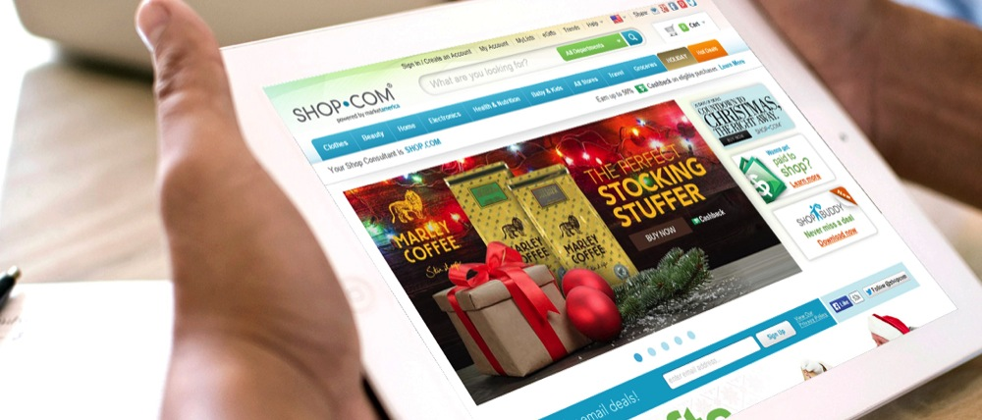

購物年金=經濟煉金術
Shopping Annuity = Economic Alchemy
THE
THE
SHOP.COM
推薦REFERRAL
好處ADVANTAGE
追蹤系統TRACKING SYSTEM
  美安香港可以追蹤並擷取所有從我們商店、品牌和商家的交易Market Hong Kong can track and capture all your purchases from our stores, brands and merchants.
  現金回贈、優惠碼、比價購物、熱賣優惠、以優惠價格購買優質產品及更好的購物體驗
  Cashback, coupon codes, comparison shopping, hot deals, better products at better prices and a better way to shop.
mhk
  當你或任何人受你直接或間接推而購物，你就可以獲得BV和IBV。When you or anyone you lead to directly or indirectly, makes a purchase you get credit in the form of a social currency called BV and IBV.
  當BV和IBV累積到一定數額時，你就可從業績紅利計劃（MPCP）中賺取永續收入。That currency accumulates and when it reaches certain thresholds, you earn a residual income through the MPCP.
Notes:
TRAINERS NOTES:
This explains why the Shopping Annuity is dependable. It works because we have a better way to shop and the technology to track it.
We aren’t asking you to shop on a site that will cause you to spend more money.
Instead we are providing you a better way to shop with all deals, programs, technology. More than that we offer better products and pay you Cashback on all of your purchases.
The referral tracking system tracks all of your spending, the spending of your referred customers and your organizations’ spending. Those margins are reflected in a social currency called BV and IBV.
You are paid on that social currency via the MPCP
The end result is a better way to shop and a solid system to track and pay you

Slide 11

推薦追蹤系統讓我們可以善用匯集一體的強大購買力︰Because of the Referral Tracking System, we can leverage our collective buying power to:
  轉利潤為永續收入Convert margins into an ongoing income
  調低價格Force prices down
  賺取更高利潤，並增加BV和IBV，從而增加你的永續收入Get better margins and give increased BV and IBV, thereby, increasing YOUR RESIDUAL INCOME
實踐劃時代概念
It’s an Idea
擁有人力、數字的力量，推薦追蹤系統，管理業績紅利計劃、SHOP.COM優勢......這劃時代概念已經來臨，而且勢不可擋。With people power, the power of numbers, The Referral Tracking system, the MPCP, the SHOP.COM advantage… it’s time has come and it can’t be stopped.
who’s time has come
Notes:
TRAINERS NOTES:
With technology today, we have the power to leverage our collective buying power!
We don’t need to solely have a consumer: retailer relationship anymore because we can recycle our money by converting the margins earned from shopping through our SHOP.COM website into an ongoing income.
Due to the massive numbers of UFOs and customers shopping through SHOP.COM, we have the power to force prices down and increase the margins that we get from those sales. That allows us to increase BV and IBV which increases your residual income and lessens the time it takes to achieve it.

Slide 12


資產Willable Asset
你每星期可賺取HK$11,500-27,600
You can reasonably expect to earn $11,500 - $27,600 /
week in perpetuity
你可以把你的資產留給你的家庭和後代
You can will this asset to family and generations to come.
Notes:
TRAINERS NOTES:
How can you keep your hard earned assets in the family?
Your UnFranchise is a willable asset and can be willed to family and generations to come.

Slide 13


你本身已不斷消費You’re Already Spending It…
何不將你的消費轉為收入﹖
Why Not Convert Your Spending Into Earning?
Notes:
TRAINERS NOTES:
Again, we are hitting this point! You are not funding this Shopping Annuity with discretionary income, but with money you are already spending.
Everybody spends money to live. You can either find a way to make that money work for you or you can continue to do what you’re doing and everything stays the same.

Slide 14

入息與開支數據 Income and Household Statistics
以下數據均來自政府統計處, 《二零零九至一零年住戶開支統計調查及重訂消費物價指數基期 》
The following is from the Census and Statistics Department (C&SD), 2009/10 Household Expenditure Survey
and the Rebasing of the Consumer Price Indices, based on consumer unit http://www.statistics.gov.hk/pub/B10600082010XXXXB0100.pdf
平均AVERAGE
消費CONSUMER UNIT 數字CHARACTERISTICS:
$586,491
$565,693
$259,476
未扣稅的收入Income before taxes
扣稅後的收入
Income after taxes
平均全年總支出Total Average Annual Expenditures
受訪者平均資料Average number in consumer unit:
住戶人數
People
18歲以下子女
Children under 18
65歲或以上成人Adults 65 and older
賺取收入人數
Earners
汽車
Vehicles
男性
Men
女性
Women
3.0
0.48
0.45
1.6
0.21
46
54
Notes:
Celine:
We need more time to localize slides 13-18 as we are waiting for latest figures from government sources.
TRAINERS NOTES:
We’ve been saying that people are spending the money. All they need to do is convert it.
Now we are going to introduce statistical evidence which proves the point that the money IS being spent. One of the biggest mental/ thinking hurdles we need to overcome when presenting this is the idea that the money is being spent. Many people make their money and spend all (or almost all of it) yet still have a knee-jerk reaction and think they couldn’t find the dollars from their current spending to transfer over. The purpose of this upcoming section is to eliminate those concerns by showing hard data.
Don’t forget to note:
These stats are not UnFranchise Stats. They are from the Census and Statistics Department (C&SD), 2009/10 Household Expenditure Survey
and the Rebasing of the Consumer Price Indices. They are can be accessed by the public.

Slide 15
錢都花到哪裡去了﹖Where does the money go?
稍後，你將會有一個簡單的每月開支和平均開支比較。Later, you will go through a simple exercise to identify how your monthly spending compares to the average spending.
食物Food
可於SHOP.COM購買並建立購物年金的項目SHOPPING ANNUITY ITEMS PURCHASEABLE ON SHOP.COM
開支Consumer Units
小計Sub Total
住屋Housing
食品(不包括外出用膳)Food at home | 2244.5
米Rice | 713.6
其他穀類和穀類製品Other cereals and cereal preparations | 56.3
麵包及糕餅Bakery products | 171
雞蛋Eggs | 28
牛肉Beef | 48
豬肉Pork | 247
家禽Poultry | 87
魚類及海鮮Fish and seafood | 314
新鮮蔬菜Fresh vegetables | 251
新鮮水果Fresh fruit | 154
其他食品Other food at home | 175
外出用膳Food away from home | 3691
酒類與煙草Alcoholic drinks and tobacco | 126
服裝與服務Apparel & Service
交通Transportation
健康護理Healthcare
6062
娛樂Entertainment
個人護理產品及服務Personal Care Product & Service
閱讀Reading
雜項MISCELLANEOUS
Notes:
Celine:
We need more time to localize slides 13-18 as we are waiting for latest figures from government sources.
Penelope:
The latest figures are from the Census and Statistics Department (C&SD), Monthly Report on
the Consumer Price Index(February 2015) http://www.statistics.gov.hk/pub/B10600012015MM02B0100.pdf
TRAINERS NOTES:
For the purpose of this demonstration, we are only going to highlight the stats on spending that could be transferred over to your Shopping Annuity.
The first of four slides, we begin by showing the money that is being spent on food. Again, we are only showing you categories that could be transferred to SHOP.COM. Notice how we only show processed fruits and vegetables and not fresh fruits and vegetables. Until we get a partner store that would fill that need, we won’t calculate fresh fruits and vegetables into our potential spending for our Shopping Annuity.
This is showing the average ANNUAL SPENDING on Food items – ask yourself – how do you think your spending compares to this?
For the food category, you probably purchase a lot of these items on a regular monthly basis. If you could plan ahead, you could convert that inevitable spending into earning.

Slide 16
錢都花到哪裡去了﹖Where does the money go?
稍後，你將會有一個簡單的每月開支和平均開支比較。Later, you will go through a simple exercise to identify how your monthly spending compares to the average spending.
食物Food
可於SHOP.COM購買並建立購物年金的項目SHOPPING ANNUITY ITEMS PURCHASEABLE ON SHOP.COM
開支Consumer Units
小計Sub Total
住屋Housing
保養住所材料Materials for house maintenance | 130
電話及其他通訊設備Residential phone service, VOIP, and phone cards | 519
其他住屋開支Other household expenses | 454
家居清潔用具及用品Laundry and cleaning supplies | 39
其他家居用品Other household products | 61
家用紡織品Household textiles | 41
大型家電Major appliances | 171
小型家電, 其他家居用品Small appliances, miscellaneous housewares | 17
其他家用設備Miscellaneous household equipment | 61
服裝與服務Apparel & Service
交通Transportation
健康護理Healthcare
1,493
娛樂Entertainment
個人護理產品及服務Personal Care Product & Service
閱讀Reading
雜項MISCELLANEOUS
Notes:
Celine:
We need more time to localize slides 13-18 as we are waiting for latest figures from government sources.
TRAINERS NOTES:
Next, we take a closer look at the average spending on household expenses.
Highlight the items purchasable on SHOP.COM
Do you purchase items in these categories?
How often do you think you purchase these item?
Some of these items may be purchased on a regular monthly basis, while others may be purchased seasonally, annually or “as needed”.

Slide 17
錢都花到哪裡去了﹖Where does the money go?
稍後，你將會有一個簡單的每月開支和平均開支比較。Later, you will go through a simple exercise to identify how your monthly spending compares to the average spending.
食物Food
可於SHOP.COM購買並建立購物年金的項目SHOPPING ANNUITY ITEMS PURCHASEABLE ON SHOP.COM
開支Consumer Units
小計Sub Total
住屋Housing
服裝與服務APPAREL AND SERVICES
3,432
3,432
服裝與服務Apparel & Service
交通Transportation
購買的和修理汽車
Purchases of and repairs to motor vehicles
80
80
健康護理Healthcare
藥物Drugs
119
712
娛樂Entertainment
醫療Medical Services
593
個人護理產品及服務Personal Care Product & Service
閱讀Reading
雜項MISCELLANEOUS
Notes:
Celine:
We need more time to localize slides 13-18 as we are waiting for latest figures from government sources.
TRAINERS NOTES:
Next we talk about Apparel, transportation and health care.
Where are purchasing your clothes and shoes?
What about Tylenol or other drugs?
Where do you book your travel or airline tickets?
Again, so much of what you are buying could be transferred to SHOP.COM to earn you money! No need to purchase anything you don’t need – just change your habits and continuing buying everything you need, FROM YOURSELF

Slide 18
錢都花到哪裡去了﹖Where does the money go?
稍後，你將會有一個簡單的每月開支和平均開支比較。Later, you will go through a simple exercise to identify how your monthly spending compares to the average spending.
食物Food
可於SHOP.COM購買並建立購物年金的項目SHOPPING ANNUITY ITEMS PURCHASEABLE ON SHOP.COM
開支Consumer Units
小計Sub Total
住屋Housing
電影娛樂Cinema entertainment | 45
旅遊Package tours | 530
玩具及嗜好Toys and hobbies | 95
其他娛樂及假期開支Other entertainment and holiday expenses | 50
服裝與服務Apparel & Service
交通Transportation
720
健康護理Healthcare
娛樂Entertainment
個人護理產品及服務Personal Care Product & Service
個人護理產品及服務
Personal care products & services
330
330
閱讀Reading
117
117
個人護理產品及服務reading
雜項MISCELLANEOUS
雜項物品及服務
MISCELLANEOUS GOODS and SERVICES
1641
1641
Notes:
Celine:
We need more time to localize slides 13-18 as we are waiting for latest figures from government sources.
TRAINERS NOTES:
Entertainment – before going to the movies, check out your website. Find every possible bit of spending that could be paying you and start transferring it over.

Slide 19
你的每月開支與每月平均開支比較，結果如何？How does your monthly spending compare to the average monthly spending?
稍後，你將會有一個簡單的每月開支和平均開支比較。Later, you will go through a simple exercise to identify how your monthly spending compares to the average spending.
食物Food
住屋Housing
服裝與服務Apparel & Service
全年開支Annual Total
$175,044
交通Transportation
健康護理Healthcare
娛樂Entertainment
每月開支Monthly Total
個人護理產品及服務Personal Care Product & Service
$14,587
閱讀Reading
雜項MISCELLANEOUS
Notes:
Celine:
We need more time to localize slides 13-18 as we are waiting for latest figures from government sources.
TRAINERS NOTES:
There are little pockets of spending everywhere that could be transferred to your Shopping Annuity. You just have to be aware of where your money is going and make a conscious decision to transfer it.
Your business is currently LEAKING MONEY everywhere. You have the opportunity to take all of this money, which statistically you are going to spend anyway and turn that spending into a residual income for yourself.
Ask yourself, how much are you missing out on? If your team is only doing 10% of their shopping on their SHOP.COM website, it’s like taking a pallet of thousands of dollars and just setting it on fire. Money wasted!
Don’t waste or underestimate the power of your current spending. Put that money to work for you and use it to build your Shopping Annuity.

Slide 20
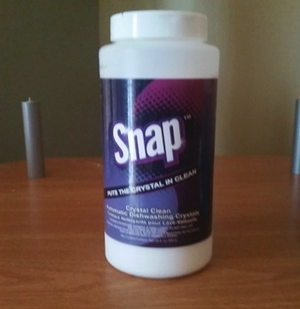

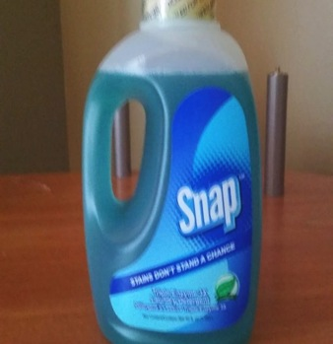



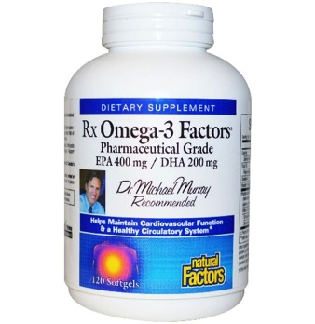

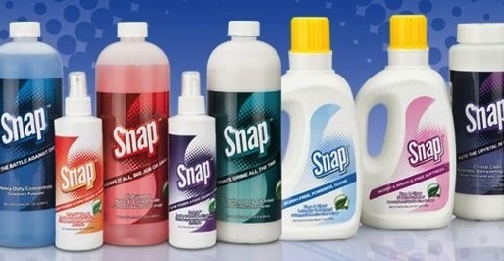

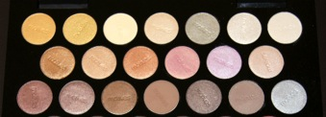
Exclusive
獨家品牌
Brands
mhk
優質產品Better PRODUCTS
優惠價格
Better Prices
現金回贈
Cashback!
現在開始使用美安獨家品牌產品建立購物年金Start identifying which of the company’s exclusive brands you could use instead of other brands to fund your Shopping Annuity®.
Notes:
TRAINERS NOTES:
Best of all, we aren’t asking you to sacrifice quality or price. Our exclusive brands are superior products, with better prices than the competition and we pay you Cashback for purchasing them.
Not to mention, by choosing these superior products, you are funding your Sh
opping Annuity

Slide 21

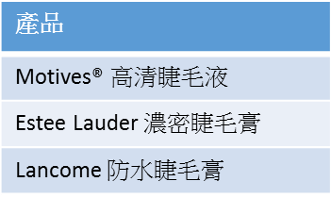
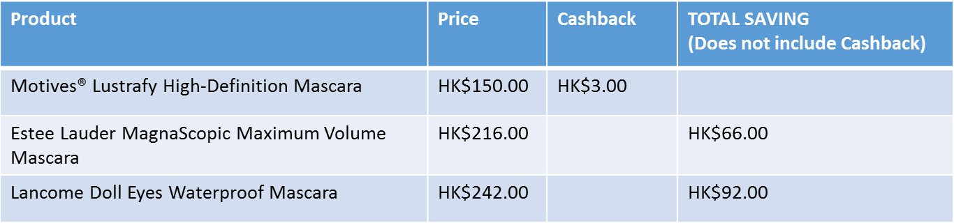
現金回贈
節省
價錢
Better Product, Better Price
Notes:
Celine:
We do have this product in HK. Please help to change the prices. We might also need to change the way to present as we don’t have comparison shopping function on hk.shop.com
TRAINERS NOTES:
How many people in the room buy makeup or know someone who buys makeup?
Are you familiar with the brand MAC or Bobby Brown?
Our award winning Motives brand is a better quality than these brands with a smaller price tag. We don’t have to pay all the traditional expenses for marketing these products so we are able to offer a better product at a better price.

Slide 22


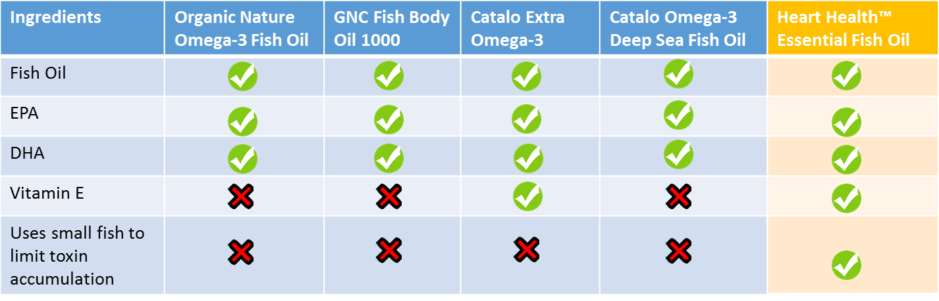
OMEGA III
Better Product, Better Price
Notes:
Celine:
We do have this product in HK. Please help to change the prices. We might also need to change the way to present as we don’t have comparison shopping function on hk.shop.com
TRAINERS NOTES:
How may people in the room take supplements? Even if you have a small commitment to your health, you are probably already taking a multivitamin, Vitamin C and Omega III
There are so many products on the market for Omega III, which don’t even have all of the active ingredients to make it effective.
Our product has everything you need, with the correct amounts needed. We are the superior product!

Slide 23


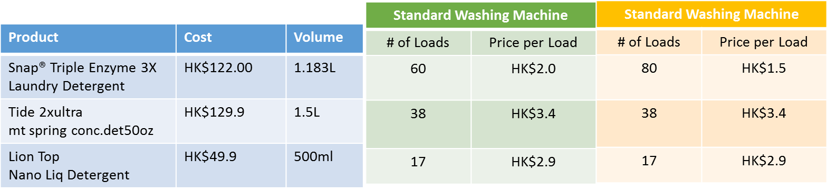
Better Product, Better Price
Notes:
Celine:
We do have this product in HK. Please help to change the prices. We might also need to change the way to present as we don’t have comparison shopping function on hk.shop.com
TRAINERS NOTES:
How many people clean their homes?
The SNAP product appears to cost more, but in reality does twice as many loads as the competition.
SNAP is the better product and is almost half the cost of the competition

Slide 24


Notes:
TRAINERS NOTES:
It’s not just about our exclusive brands, we provide a better way to shop.
This is a transitional slide that will highlight some of the most exciting parts of SHOP.COM

Slide 25
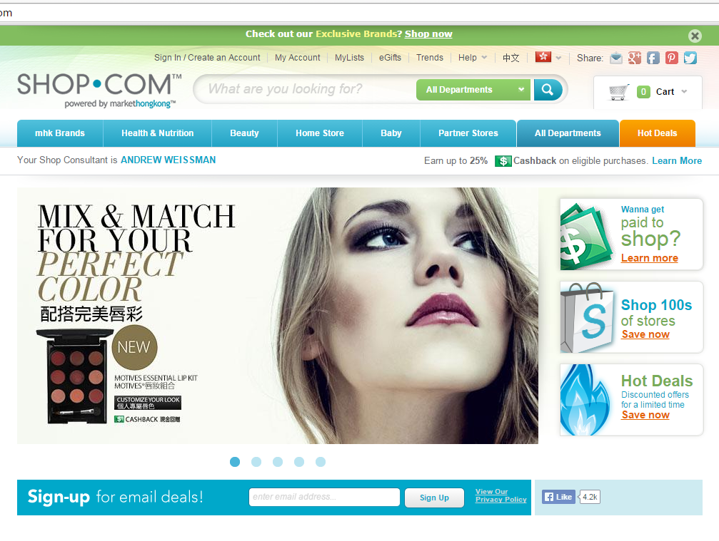
現金回贈Cashback
Notes:
TRAINERS NOTES:
We have a CashBack program that pays you and your customers cash back on everything you buy through our site.
This Cashback is credited to you in addition the BV and IBV you earn on your purchases

Slide 26
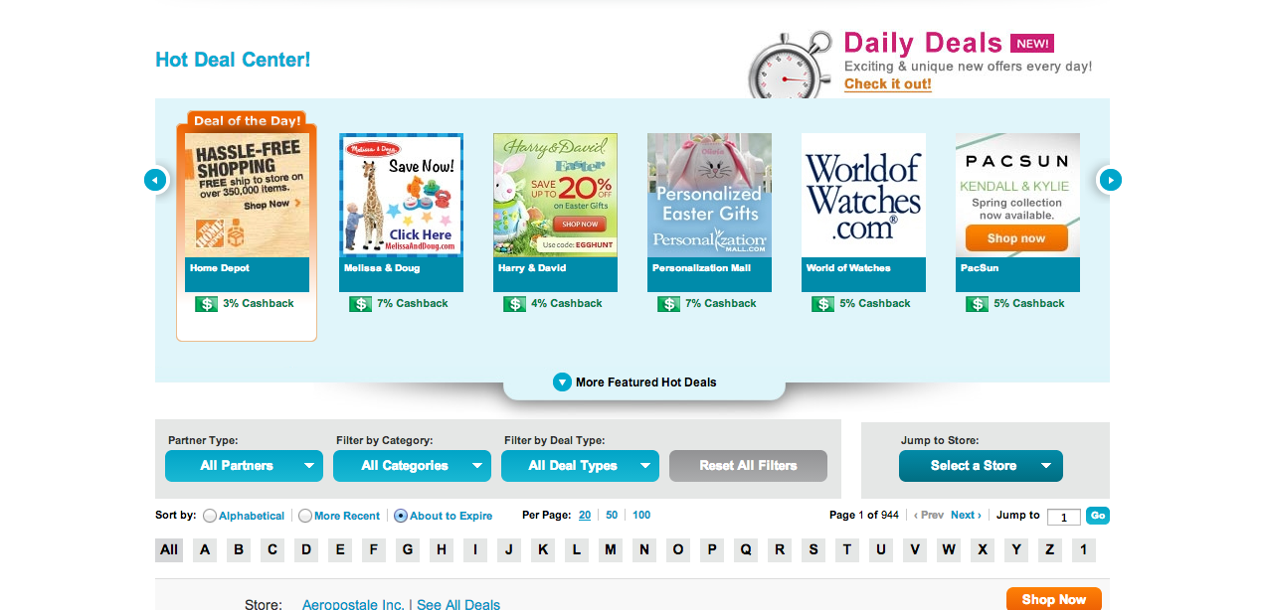
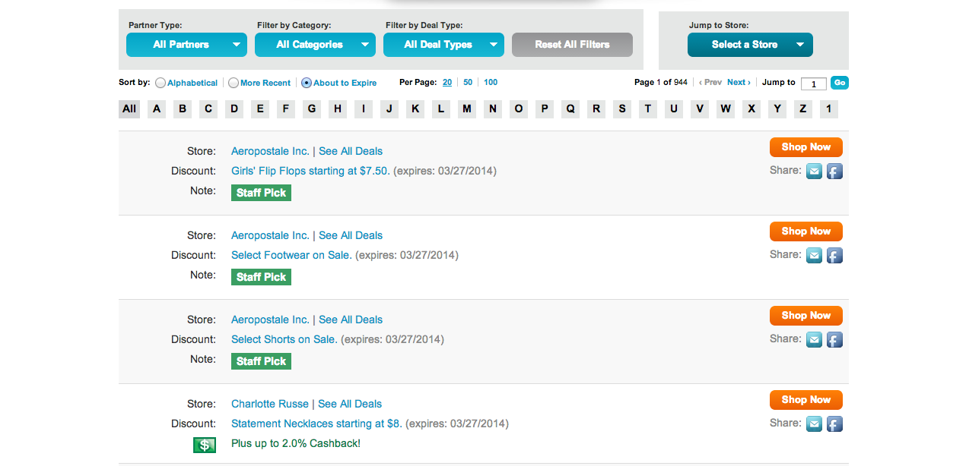
熱賣
優惠
HOT
DEALS
Notes:
TRAINERS NOTES:
We even created a section on our site which shows the hottest deals at our partner stores, while highlighting some of the best ones at the top.
We make shopping easier.

Slide 27


如何投資你的購物年金﹖
How Do You Fund Your Shopping Annuity®?
由改變你的
It Begins by
Adjusting Your
購物習慣Shopping
Behaviors
開始
Notes:
TRAINERS NOTES:
Do you agree that you are spending the money anyway?
Can you see all of the places where you could be earning?
Before you can implement our system for success, you have to acknowledge the change of shopping habits.

Slide 28
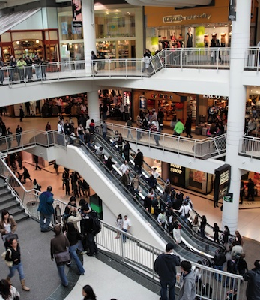

逛街購物Brick and Mortar
網上購物Click and Order
to
Notes:
TRAINERS NOTES:
You have to be aware of the money you would “leak” in the stores and switch it to SHOP.COM
If you are already an online shopper, you have to shift your spending behaviors to go through SHOP.COM first or simply install and login to ShopBuddy to make sure you are funding your Shopping Annuity.

Slide 29


節省的金錢Money SavED
=
賺到的金錢
Money earnED
40%
節省交通開支TRANSPORT Saving
每年交通平均開支Avg. Spend Transport per/yr. $21,558
40%開支用於購物40% Transport is used to go shopping
$8,623用於購物
$8,623 transport on shopping
Notes:
Celine:
Majority of us don’t have a car but just take public transport to travel around the city. We replace gas savings to transport saving on this slide.
TRAINERS NOTES:
This shopping behavioral change will not only fund your Shopping Annuity, it will actually create even MORE savings right for you!
If 40% of gas is used to go shopping and you could save an average of $8,623 – wouldn’t that be extra income in your pocket that you could save or redirect to your Shopping Annuity?
Wouldn’t you agree that even if you only saved 20% – 30%, it would still be worth the gas savings?
Wouldn’t you agree that some people spend even more than 40% of their gas money to go shopping?
Savings on gas and wear and tear on your car = money saved = money earned!

Slide 30

節省的金錢Money SavED
=
賺到的金錢
Money earnED
你的時間就是金錢Your Time is Worth Money
你每年收入Your Annual Income
$828,400
你的時間寶貴嗎﹖
Was your trip worth it?
對不對﹖
Yes or No?
每週工時Hours Worked Per Week
40
時薪What Your Time is Worth Per Hour
$398.27
每年的開支
每星期你到商店購物的次數
Number of Times Per Week You Take a Trip to a Store
4
每次所需時間(分鐘)Minutes Spent Per Trip
$48,323
35
Notes:
Celine:
Figures changed to HK amounts.
TRAINERS NOTES:
A successful UFO conservatively earns $828,400 per year. Your time is worth money! You could spend that time driving to stores, shopping around and driving home or you could be spending that money to build your business.
This breaks it down for a UFO earning $828K/year – even if you made half of this income and created half of the savings, isn’t it worth it?
If you make more money, your potential savings are even higher!

Slide 31

節省的金錢Money SavED
=
賺到的金錢
Money earnED
這可以慳得更多﹗That’s a lot of Savings!
$8,623
$48,275
$56,898
40%交通費$21,558
40% of transportation $21,558
你的時間值
Value of Your time
每年
Per Year
這些還不包括你從購物中所慳的 錢、現金回贈和在你團隊中複製之後所慳的錢﹗And those savings don’t include price savings on purchases, Cashback, and duplicating it with your team!
完成購物年金評量表評估你可以節省的金錢。
Complete the Shopping Annuity® Assessment to identity your personal potential savings.
Notes:
Celine:
Figures changed to HK amounts.
TRAINERS NOTES:
All in all, it costs money to shop when you are driving to and from stores. By switching your behavior to shop through your SHOP.COM site, you are saving over $9K right off the bat – and that doesn’t even include the prices savings, Cashback earned etc.

Slide 32

把你的日常消費成為投資本金建立屬於自己的購物年金Create your “Fixed Sum” Payment using your current spending to create a residual income for yourself
慳錢Save Money
購物年金創造
The Shopping Annuity® Creates
經濟動力Economic Synergy
賺錢Earn Money
把過程在你的團隊和顧客間複製，以增加和累積你的購物年金﹗
Duplicate the process with your organization & customers to accelerate and increase residual income!
Notes:
TRAINERS NOTES:
This is another slide to bring the big point Home!
It’s a summary slide that shows the power of the Shopping Annuity
This is a transition to illustrate exactly why it works and how it works

Slide 33

威力倍贈帶來更強的效果
A Forced Multiplier for
Stronger Results
購物年金就像一部威力倍贈器在業績紅利計劃中累積你的購物年金The Shopping Annuity acts as a forced multiplier to accelerate a residual income generated by the MPCP.
購物年金使新超連鎖店主更快賺取佣金和晉升到新超連鎖級別New UFOs will earn commissions and achieve new UnFranchise Levels faster by leveraging the Shopping Annuity.
超連鎖店主所賺取的佣金在可增加他們事業中約50-100%的利潤Current UFOs earning commissions can increase their income 50% to 100% from their existing business.
購物年金可以減省75%人力而又可賺取一樣的佣金
The Shopping Annuity® takes 75% fewer people to earn the same amount of commissions.
購物年金是業績紅利計劃的噴射器，助你和你的團隊每年賺取$187,000 的永續收入。The Shopping Annuity is rocket fuel for the MPCP, helping you and your team generate a residual income of $187,000 per year.
Notes:
TRAINERS NOTES:
Explain these five points. The idea is that the shopping annuity is rocket fuel for the MPCP. It causes a forced multiplier for the business. Takes fewer people and creates larger incomes.
TRANSITION – Let me show you exactly how this works -

Slide 34
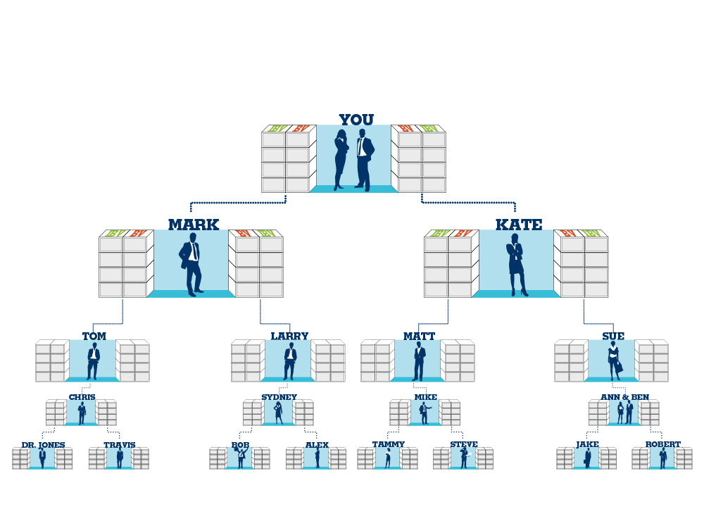
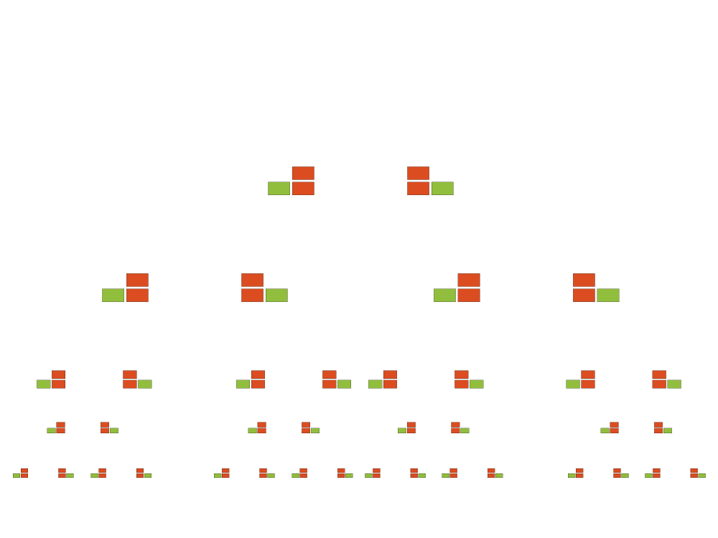
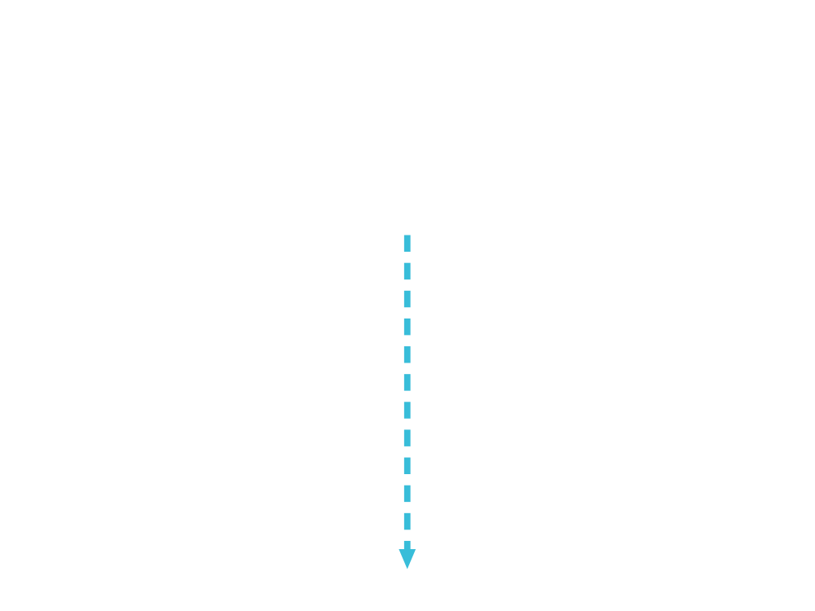
$4,600 每月each month (BV) & $2,300 每第三個月every third month (IBV)
50 x 50 BV = 2,500 BV
50 x 10 IBV = 500 IBV
50 x 50 BV = 2,500 BV
50 x 10 IBV = 500 IBV
Notes:
Celine:
Figures changed to HK amounts.
TRAINERS NOTES:
This is an organization of 50 people on the left and 50 people on the right
Everyone is doing the minimum activity requirements / not participating in the Shopping Annuity
The multiplier is small because noone is really doing the business and definitely not doing the shopping annuity , therefore only creating $600 per month in BV checks and $300 every 3 months in IBV commissions.

Slide 35
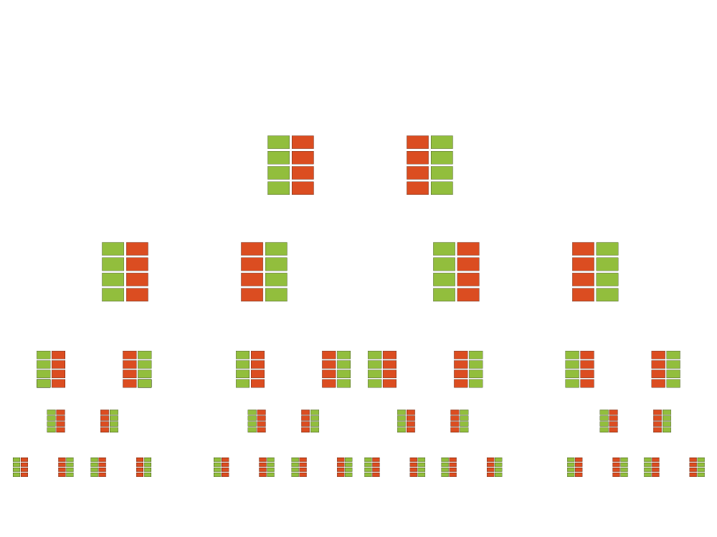
$57,500 每月each month (BV) & $23,000 每月every month (IBV)
50 x 500 BV = 25,000BV
50 x 200 IBV =
10,000 IBV
50 x 500 BV = 25,000 BV
50 x 200 IBV =
10,000 IBV
Notes:
Celine:
Figures changed to HK amounts.
TRAINERS NOTES:
Look at the incredible difference when you take that exact same organization and have everyone doing the Shopping Annuity
The SA is the forced multiplier!
With everyone committing to the Shopping Annuity, that same organization is creating a way more substantial income for your business… $7,500/month in BV commissions and $3,000/month in IBV Commissions.

Slide 36

購物年金可以減省75%人力而又可賺取一樣的佣金
The Shopping Annuity® takes 75% fewer people to earn the same amount of commissions!
Notes:
TRAINERS NOTES:
Because of the forced multiplier, you earn a substantial income and only need to build a business with 25% of the partners.
Think about it, you could build a “business’ of people doing the minimums with 50 on the left and 50 on the right to create $600/month OR
You could build your business to $600/month with 5 on your left and and 5 on your right
The Shopping Annuity = Rocket Fuel for the MPCP! It gets you there faster, with fewer people and everyone is successful sooner!

Slide 37
這是你的選擇
It’s Your Choice
你不斷消費使其他人和公司賺錢
You can continue to spend money and make other companies and people money
利用購物年金轉消費為收入及幫自己賺錢You can Convert Your Spending into Earning with the Shopping Annuity® and help make yourself money?
或OR
你想要哪一種﹖Which do you Prefer?
Notes:
TRAINERS NOTES:
This is critical! Do not skip through this slide. It’s the equivalent of the the slide in the UBP which asks if they want the 45 year plan or the UnFranchise.
You can continue to spend money you are already spending the way that you’re spending it. This will continue to make money for the companies you purchase from and earn you nothing. Nothing changes! OR
You can convert your spending into earning. Continue to purchase all of the things you are going to purchase anyway and be paid on those margins from your spending as well as the spending of anyone you lead to directly or indirectly.

Slide 38

購物年金THE SHOPPING ANNUITY®
^{注資計劃}FUNDING PLAN
Notes:
TRAINERS NOTES:
Now that you agree, let’s go through the Shopping Annuity Funding Plan
This is a transitional slide that is going into the 4 steps.

Slide 39

購物年金由超連鎖店主完成購物年金評量表開始THE SHOPPING ANNUITY BEGINS WITH EACH UFO COMPLETING THE
SHOPPING ANNUITY ASSESSMENT
1
  購買美安品牌產品創造BV
  Create BV with our Exclusive Brands
4
2
  透過SHOP.COM於夥伴商店購物創造IBV Create IBV with Partner stores on SHOP.COM
個步驟建立
STEPS To BUILD A
3
  複製
  Create Duplication
購物年金
SHOPPING ANNUITY®
4
  借助顧客創造BV和IBV
  Create BV & IBV with Customers
Notes:
TRAINERS NOTES:
Transitional slide.
The big point to make here is that there is proven system and tools to support the actions required to be successful. You don’t have to ambiguously go about funding your shopping annuity. You can make calculated decisions and duplicate that process with your team to create a shopping annuity for yourself.

Slide 40

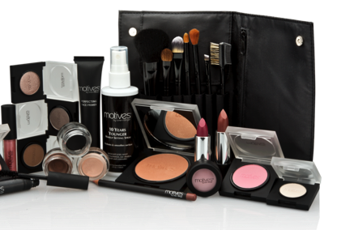
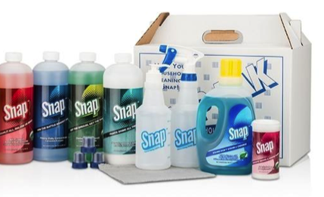



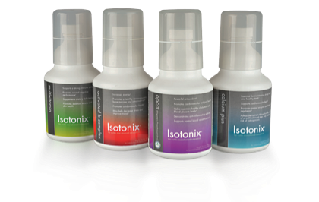



購買美安品牌產品創造BV
Create BV with the company’s Exclusive Brands
把日常購買的產品轉換成美安品牌產品
Change the brands of products you are currently buying for your household to the
company’s exclusive brands.
  把M.A.C. 轉成Change from MAC to
  Motives
  把Tide轉成Change from Tide to SNAP
  把Clinique轉成Change from Clinique to Lumiere de Vie
  把善存轉成Change fro Centrum to Isotonix
Notes:
TRAINERS NOTES:
The first step is to identify which brands you are currently buying that could be switched over to the company’s exclusive brands
Repalce Mac with Motives, Tide with Snap, Clinque with Lumiere, Centrum with Isotonix etc.
Remember, we aren’t asking you to sacrifice the quality or price savings. We offer a better product at a better price.

Slide 41
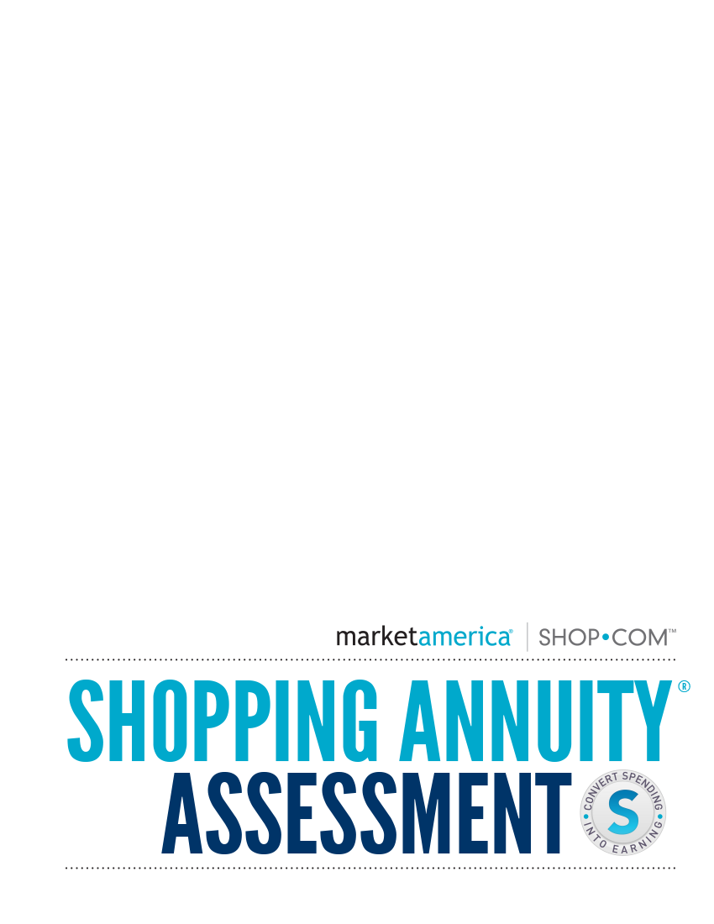

完成Complete the
購物年金Shopping Annuity® 評量表Assessment
下載Download at:
www.shoppingannuity.com
購物年金評量可以︰The Shopping Annuity Assessment will:
    分辨可被美安品牌取代的產品Identify the products you could replace with the company’s exclusive brands.
    計算可賺取BV和現金回贈數目
    Calculate the BV and Cashback Potential
Notes:
TRAINERS NOTES:
We offer hundreds of exclusive products and we know that you probably only use or are even aware of a handful of them. That is why we created the Shopping Annuity Assessment Handbook and Workbook.
You can download the handbook and workbook at Shoppingannuity.com
From there, you can complete exercise 2
You enter in your household size: number of adult females, males, children, pets and cars
Take 15 minutes to go through a put an “x” next to each of our exclusive brands that you might use
Click “Calculate my Shopping Annuity Potential” and it will tell you the potential monthly and quarterly BV that you could be earning to fund your Shopping Annuity.

Slide 42

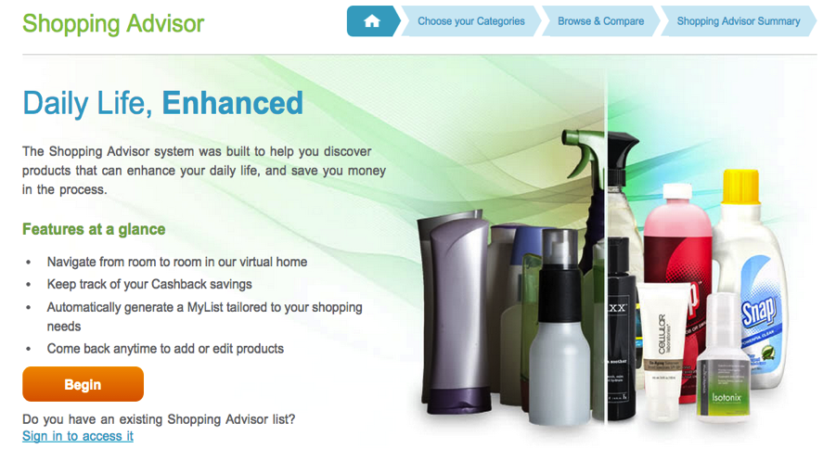
購買我們的品牌創造BV Create BV with
OUR Brands
當開始購物年金評量表時，到SHOP.COM並完成購物建議Once you’ve taken the Shopping Annuity Assessment, go to SHOP.COM and complete the Shopping Advisor.
這會助你分辨可以建立購物年金的產品This will identify the specific products that you can use to fund your Shopping Annuity®.
要完成這程序，把這些指定產品加進你的自動購貨To complete this process, add the identified products to AutoShip so you never run out.
Notes:
TRAINERS NOTES:
Once you’ve seen the potential, you can complete the online Shopping Advisor on SHOP.COM.
This will even create a “My List” for you which will make buying products easier!

Slide 43

將平時要逛街購買其他品牌和產品Change how you buy all other brands and products directly from other establishments
轉成to
在你的SHOP.COM網站購買﹗
buying them through your own
SHOP.COM website!
夥伴商店創造IBV
Create IBV with
Partner Stores
Notes:
TRAINERS NOTES:
The second step is to identify all of the other places you spend money with other stores and change HOW YOU BUY THEM.
You can’t convert 100% of your buying to our brands, so identify how you can get everything else you need from our partners through SHOP.COM
Again – same products / Same retailers = just shift the behavior to buying it through your SHOP.COM website

Slide 44
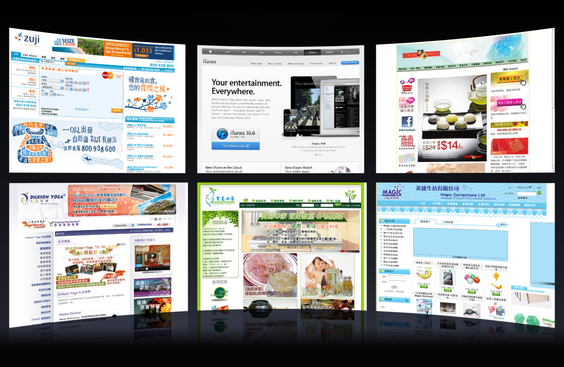
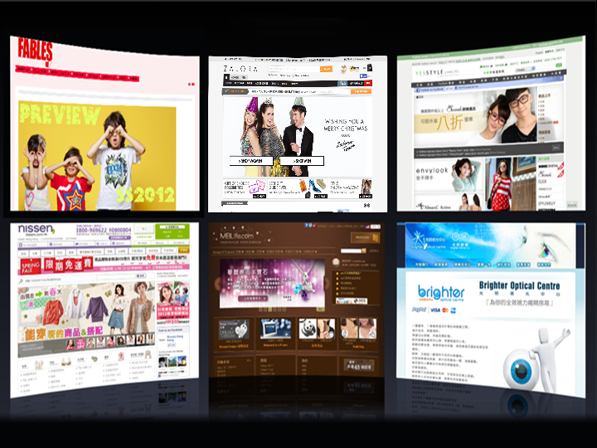
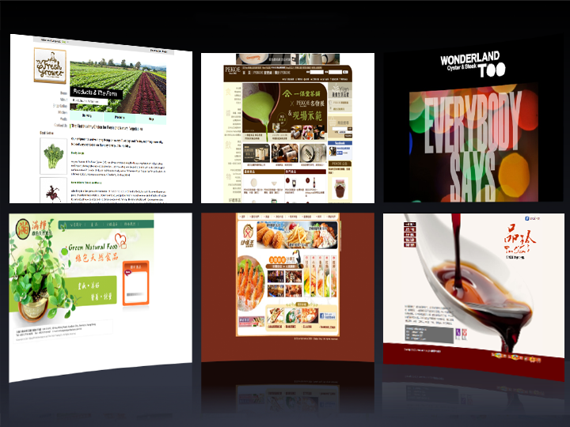
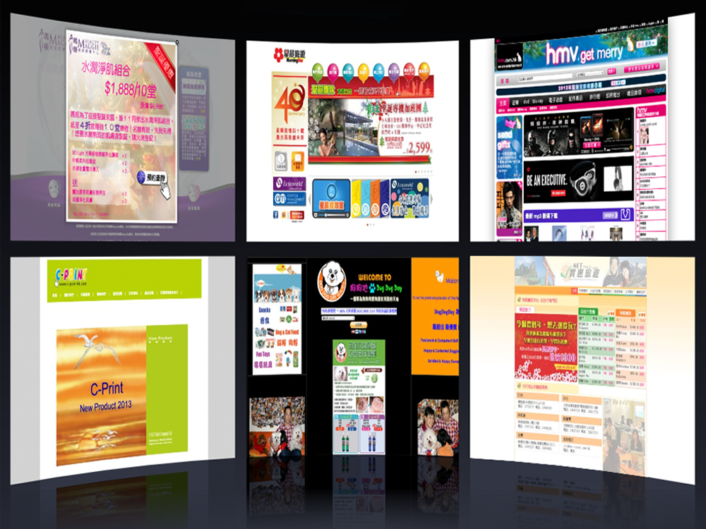
























夥伴商店
Partner Stores
夥伴商店Partner Stores
夥伴商店
Notes:
Celine:
Changed to HK Partner Stores.

Slide 45
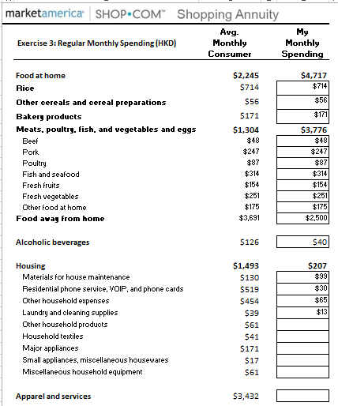
完成購物年金評量表Complete the
Shopping Annuity® assessment
Exercise 4: Seasonal Spending
 |  | My Monthly Seasonal Spending:
 | Q1: January / February / March
 | New Years:
 | Chinese New Years:
 | Three Kings Day:
 | Valentine’s Day
 | Super Bowl:
 | World Conference
 | Mardi Gras:
 | St.Patrick’s Day:
 | Winter Clothes
 | Birthdays:
 | Anniversaries:
 | Other:
 | Q2: April/ May / June
 | Passover:
 | Palm Sunday:
 | Easter:
 | Administrative Professionals Day:
 | Cinco De Mayo:
 | Mothers Day:
 | Memorial Day:
 | Fathers Day:
 | Spring Appliances / Furniture / Décor
 | Spring Clothing
 | Birthdays:
 | Anniversaries:
 | Other:
 | Q3: July / August / September
 | Independence Day:
 | International Convention:
 | Vacation:
 | Labor Day:
 | Back to School:
 | Rosh Hashanah:
 | Summer Clothes
 | Birthdays:
 | Anniversaries:
 | Other:
 | Q4: October / November / December:
 | Yom Kippur
 | Boss’s Day:
 | Halloween:
 | Veteran’s Day
 | Thanksgiving
 | Black Friday
 | Cyber Monday
 | Chanukah
 | Christmas
 | New Year’s Eve
 | Fall Clothes
 | Fall Décor
 | Birthdays:
 | Anniversaries:
 | Other:
 | Annual Spending:
 | Electronics: | $600
 | Appliance: | $1,200
 | Other:
 | Total Seasonal Spending: | $1,800
下載Download at www.shoppingannuity.com
  購物年金評量表助你︰ The Shopping Annuity® Assessment will help you identify:
  每月必要開支
  Your regular monthly spending
  每年在節日、假期和活動開支Your annual spending triggered by events, occasions and special purchases.
  (i.e: Mother’s Day, birthdays, anniversaries etc.)
  如何透過SHOP.COM改變購物習慣建立購物年金How you can change your habits to shopping through your SHOP.COM website to fund your Shopping Annuity.
Notes:
TRAINERS NOTES:
In that same Shopping Annuity Assessment Workbook and Handbook, you will complete exercise 3 and 4 to identify all of your monthly, seasonal and annual spending that you do. It’s important to have the shopper of the household present when completing these exercises to have the most accurate results and to get the best adaption.
In exercise 2:
You will see all of those categories of monthly spending that could be transferred to SHOP.COM
To the right, you will be reminded of the average monthly spend on that item
To the right of that reminder, you can enter in what YOU spend monthly on each given item
How does your monthly spending compare?
In exercise 4, we prompt you to think about all of the other items you buy throughout the year. We organized it by quarter to help focus your thinking so you could identify every area that your business may be leaking potential BV and IBV!
In the Shopping Annuity Assessment Handbook, we included a list for your reference with our most reliable partner stores, organized by category. This will give you a nice starting point for where to buy the items you identified in these two exercises.

Slide 46

借力
Create Leverage
  通過執行4步驟致力改善個人財務狀況的。Identify individuals committed to improving their financial situation by performing
  Steps 1-4.
  在團隊中複製及一起完成購物年金評量表
  Complete the
  Shopping Annuity® Assessment together to duplicate it with your organization.
  完成購物年金手冊及一起創造最大的BV和IBV
  Complete the
  Assessment Workbook and work together to create massive BV and IBV.
Notes:
TRAINERS NOTES:
The Shopping Annuity is bigger than just converting your own spending. You have to duplicate it for maximum results. The next step is critical! You have to get your organization to fund their shopping annuity as well.
Use the resources provided to you so that everyone is on the same page and completing the right actions

Slide 47

  找出10至15名顧客來改變其消費習慣，以符合步驟1與2的要求，與他們建立夥伴關係(超連鎖店主)。 Identify 10-15 individuals and build relationships to create lifetime value in customers or future business partners (UFOs).
顧客購買美安品牌產品可賺取現金回贈Customers get paid Cashback for purchasing the company’s exclusive brands.
顧客透過你的入門網站到夥伴商店消費可賺取現金回贈Customers get paid Cashback for purchasing from our partner stores through SHOP.COM/yoursite.
借助顧客創造BV和IBV
Create BV & IBV with
顧客透過你的入門網站推薦顧客消費亦可賺取現金回贈Customers get paid cashback for referring Customers to SHOP.COM/yoursite to do the same.
Customers
Notes:
TRAINERS NOTES:
Don’t forget to build share of customer! You can create additional BV and IBV by creating lifetime value with your customers.

Slide 48
發展成熟的購物年金Your
Shopping Annuity® at Maturity
預計開支與收益
Spending and Earning Projections
 | 1 YR | 3 YR | 5 YR | 10 YR
現時賺取Current Earning | $164,160 | $492,480 | $820,800 | $164,160
預計賺取Projected Earning | $300,960 | $902,880 | $1,504,800 | $300,960
完成4個步驟就可發展成熟的購物年金讓你得到永續收入The result of completing the four steps is a matured Shopping Annuity that will continue to generate an ongoing income.
你正在轉消費為收入You are Converting Your Spending into Earning
你正在把你的消費投資你的購物年金You are funding your Shopping Annuity with money you’re already spending
Notes:
Celine:
Changed to HK amounts.
TRAINERS NOTES:
Once you’ve completed the four steps and are funding your shopping annuity, your shopping annuity will mature over time.
Take a look at the increased income for those who those who build their shopping annuity.
You were earning $164,160 in year 1. With the shopping annuity, your projected earning increases to $300,960!

Slide 49
購物年金獎賞庫計劃的目的
合格超連鎖店主要賺取額外BV和IBV獎勵，必須達到購物年金紅利基金資格要求，因此要轉為在購物年金模式下透過超連鎖事業賬戶和SG.SHOP.COM購物，以此方式轉消費為收入並創造永續收入。
購物年金紅利基金為超連鎖店主提供優渥獎勵，以鼓勵他們立即參與；並為超連鎖店主資深夥伴/領導人提供更優渥獎勵，以鼓勵他們促成此事。
The Shopping Annuity® Bonus Pool criteria that must be satisfied to receive the bonus BV and IBV by qualifying UFOs results in a model Shopping Annuity transferring their shopping to their UnFranchise business and SHOP.COM. Thus, converting spending into earning and creating a residual income.
The Shopping Annuity Bonus Pool provides a large incentive for UFOs to do this immediately and a larger incentive for UFO senior partners/ leaders to make it happen.
Notes:
TRAINERS NOTES:
The company reward UFOs for building their Shopping Annuity
In addition to the increased BV and IBV – you can be credited with a Bonus for achieving the standards set forth each quarter.

Slide 50
購物年金獎賞庫計劃
如果你符合每個日曆季度SABP資格要求，你將可以分享200-400BV和50-100IBV。
要獲得200-400BV和50-100IBV必須每季度符合購物年金獎賞庫計劃資格
除了你自己要合格外，你的團隊亦需要合格，就像業績紅利計劃那樣。
To qualify and be eligible to receive a share of BV (around 200BV to 400BV and IBV around 50 to 100) a UFO must satisfy the SABP criteria for each calendar quarter.
The BV and IBV accumulation on the qualifying volume and the bonus BV and IBV on each organization's UFO is huge!
You must qualify for it yourself to receive 100% credit on everyone on your team that does it and that is where the big money is made…just like the MPCP. They work together!
Notes:
TRAINERS NOTES:
These are the requirements to be rewarded / achieve the bonus pool

Slide 51
成為購物年金獎賞庫計劃優勝者
完成購物年金評量表
IBV 要求︰在本國夥伴商店購物累計達HK$23,000(首先，必須利用合格超連鎖™店主的個人優惠顧客ID（優惠顧客編號為7位數）作為付款人，購物達HK$11,500.00)
必須購滿1,500 BV美安香港產品，付款人為合格的超連鎖™店主（超連鎖™店主編號為9位數）
Complete the Shopping Annuity Assessment
Generate HK$23000.00 HKD worth of qualified IBV purchases between you and your customers in your home country. (In order to count the IBV purchases from your customers, you must personally generate at least HK$11500.00 HKD)
Generate 1500 BV of personal purchases (purchases will be tracked from the Paying ID).
在美安香港的夥伴商店購物累計達HK$23,000.00：
1) 首先，必須利用合格超連鎖™店主的個人優惠顧客ID（優惠顧客編號為7位數）作為付款人，購物達HK$11,500.00
2) 之後則可由註冊優惠顧客或超連鎖™店主本人購滿季度總數HK$23,000.00之其餘部分
You can do it all yourself from shopping (this requirement is based on 80% of what the average person statistically spends) or… to give lee way and a head start:
At least $11,500* in purchases with the qualifying UFO’s Personal Preferred Customer ID
(7-digit #) being the paying ID.
The remaining balance of the $23,000 total for the respective quarter may be made up from purchases made by your registered Preferred Customers, or yourself.
Note: All returns will be deducted and reconciled against totals
Notes:
Celine:
Changed to HK SABP requirements.
TRAINERS NOTES:
Steps for Success!

Slide 52
購物年金獎賞庫計劃額外獎賞
BV和IBV獎勵！你符合資格時，就能從購物年金獎賞庫計劃中得到可以放置的額外BV和IBV獎勵（大約為：200至400 BV以及50至100 IBV）。
複制額外BV和IBV獎勵：如果你符合購物年金獎賞庫計劃基金資格，在你親自推薦的任何一位超連鎖店主也同樣合格時，即可另外獲得50 BV和25 IBV。
IBV紅利計劃下的S$750 領導獎金：此外，當你符合購物年金獎賞庫計劃資格，並在一個商業發展中心的左右兩邊組織，各有10名同樣也購物年金獎賞庫計劃資格的超連鎖店主時，此商業發展中心將可於接下來的12周中，在IBV紅利計劃下（與BV紅利計劃規則相同）額外賺取$4600。此為發放給每個商業發展中心的獎勵，越多合格商業發展中心，則可獲得越多IBV獎勵。請註意：此12周周期起於BV與IBV獎勵發放當周。
累積BV和IBV！所有符合購物年金獎賞庫計劃資格要求的超連鎖店主，都可累積由自己的組織內產生及/或放置的額外BV及IBV獎勵。請組織並動員你的團隊夥伴立即行動。凡是做好準備並采取行動的團隊，都能創造極多BV和IBV。
BONUS BV and IBV! When you qualify you get the additional Bonus Pool BV and IBV to place (Estimated :200 to 400BV and 50- 100IBV).
DUPLICATION BONUS BV and IBV: If you qualify for the bonus pool, you will also automatically earn an additional 50 BV and 25 IBV for each of your personally sponsored UFO that qualifies as well.
$4600 LEADERSHIP BONUS IN IBV ELIGIBILITY: in addition, if you qualify for the bonus pool and have 10 UFOs in the left organization and 10 in the right organization of a BDC that qualify for the bonus pool; that BDC will be eligible to earn an additional $4600 Bonus in the IBV compensation plan (same rules as the BV Bonus) for the next 12 weeks. This bonus is per BDC, so multiple BDCs are eligible for the IBV bonus. Note: the 12 week period will start the first week bonus BV and IBV are awarded.
BV and IBV ACCUMULATION! All UFOs qualifying for the Shopping Annuity® Bonus Pool will be eligible to accrue all awarded bonus BV and IBV generated and/or placed within their organization. Organize and mobilize your teams for massive action. The BV and IBV created will be enormous to those organizations that prepare and act!
Notes:
Celine:
Changed to HK amounts.
TRAINERS NOTES:
Steps for success continued!

Slide 53
勢不可擋的強大威力
You Can Not Stop an Idea Whose Time has Come!
購物年金THE SHOPPING ANNUITY® = 超連鎖™DNA UNFRANCHISE™ DNA
完成購物年金評量表Complete the Shopping Annuity® Assessment
?
購物年金優於任何其他方式的投資。無論金融市場如何波動，也無論你手頭是否有用於投資的可隨意支配收入，都不會影響購物年金；每個人生活中都要購物和消費。只要你改變購物習慣，透過HK.Shop.com以優惠價格購買所需產品，以美安獨家品牌
取代以前所用的產品。The Shopping Annuity works better than any investment. Regardless of the performance of financial markets and the amount of discretionary income you have or don’t have to invest; everyone shops and has to spend to live. Simply change your shopping habits. Buy the same products and brands for less money through Shop.com and change to Market America’s exclusive brands.
藉助改變你的購物與消費方式，證明你能節省$56,898甚至更多。只要改變，就能勝出。
可核查並確認是否達到購物年金獎賞庫計劃資格要求。
讓你認清你的每月開銷和年度開銷。為你展示如何在HK.SHOP.COM或HK.UnFranchise.com找到所需的產品。
為你設立一個計劃、規劃和系統。
Proves you save $56,898 or more by changing the way you shop and spend money. It’s an automatic win
It verifies and validates the criteria in the Shopping Annuity Bonus Pool
Identifies money you are already spending monthly and annually. It shows you where to find the products on SHOP.COM or UnFranchise.com.
It creates up a plan, projections, and a system for YOU.
?
?
The choice is yours. Make the decision to convert your spending into earning. Save $56,898 or more by changing your shopping habits from brick & mortar to click and order.
Notes:
Celine:
Changed to HK amounts.

Slide 54
購物年金獎賞庫計劃Shopping Annuity® Bonus Pool Program
促進超連鎖發展的計劃
Shopping Annuity Bonus Pool – The Most Colossal Promotion in UnFranchise History
每季度有2千萬額外BV和1千萬IBV﹗ 所有人都可從MPCP中得益。全年有8千萬BV和4千萬IBV
Up to 20 million Bonus BV and 10 million IBV each quarter! Rolls up in MPCP for all to benefit.
80 million BV and 40 Million IBV for the year
?
?
?
最高2千萬BV Up to 20 million BV
  最低2百萬BV 2 million minimum
  遞增至2千萬 Graduated scale of up to
  20 million
最高5千萬IBV Up to 5 million IBV
  最低1百萬BV 1 million minimum
  遞增至1千萬 Graduated scale of up to
  10 million IBV
超連鎖DNA UnFranchise DNA =
購物年金SHOPPING ANNUITY
By completing the steps and changing where you order to SHOP.COM
每季度Each Quarter:
1500 BV
$23,000夥伴商店 from SHOP.COM
PARTNER STORES
這是看看你有沒有超連鎖DNA的時候。行動的UFO就可得到最高2千萬BV和1千萬IBV。而所有的額外BV和IBV都會滾存給資深夥伴。因此，團隊中越多UFO行動，表示你將會有更高的收入和超連鎖級別。
This is YOUR UnFranchise DNA test to see if you have it or not.
Up to 20 million BV and Up to 10 million IBV up for grabs to UFOs who do it.
All of the Bonus BV and Bonus IBV rolls up to Senior Partners. Therefore, the more UFOs on your team that do it the more you make while they increase their income achieve UFO levels
Notes:
Celine:
Changed to HK amounts.

Slide 55
購物年金獎賞庫計劃SA Bonus Pool Program
?
?
?
特點SPECIAL FEATURES
在SHOP.COM中使用顧客$500IBV。 Can use customers for half of the$1000 IBV from SHOP.COM
在組織中複製，你可從每位合格UFO中額外獲得50BV和25IBV。Create duplication with your organization. You earn an additional bonus of 50 BV and 25 IBV for each qualifying UFO in your organization
左加組織各有10位合格UFO，可獲得額外IBV。Get 10 UFOs on each side of your organization to qualify, you become eligible to earn a IBV Bonus check.
行動Take Action
完成評量表Take the Assessment
購物建議Shopping Advisor
轉到SHOP.COM上消費，創造BV和IBV Transfer your buying to SHOP.COM and create BV and IBV
符合購物年金獎賞庫計劃要求Qualify for the Shopping Annuity Bonus Pool
你團隊中任何人合格都可以100%累積到業績紅利計劃的上線中。團隊中越多人合格，你就得到越多BV和IBV。REMEMBER THAT EVERYONE WHO QUALIFIES ON YOUR TEAM ACCUMULATES UPLINE 100% TO YOUR CREDIT IN THE MPCP. THE MORE UFO’S YOU HAVE QUALIFIED- THE MORE BONUS BV AND IBV YOU GET

Slide 56


下一步︰瀏覽WWW.SHOPPINGANNUITY.COM
Next Step: Visit WWW.SHOPPINGANNUITY.COM
  下載購物年金評量表及手冊 DOWNLOAD THE SHOPPING ANNUITY® ASSESSMENT HANDBOOK AND WORKBOOK
  與團隊一起完成評量表COMPLETE THE SHOPPING ANNUITY ASSESSMENT WITH YOUR TEAM
Notes:
TRAINER’S NOTES:
Closing!
Call to Action – your next steps are set and simple:
Go to shoppingannuity.com
Download the Shopping Annuity Handbook and Workbook
Complete the Assessment
Have your team complete the assessment
Start spending your spending into earning

Slide 57
購物年金
The Shopping Annuity®
轉消費為收入
Convert Spending Into Earning
Notes:
TRAINERS NOTES:
Welcome guests. Let them know that why you’re excited to be sharing this revolutionary concept with them.
It gives everyone a chance to enjoy the benefits of annuity without having to fund it with discretionary income, but rather with money they are already spending
We are going to show you how you could create a residual income for yourself by simply changing how you shop and duplicating it with your team
This plan is essentially rocket fuel for the MPCP.
Share any of your personal success or team’s success with the Shopping Annuity

